Slide 1
LOGISTICS AND INFRASTRUCTURE
Satakunta

Slide 2
1
Connections
Pori Airport
Continuous Improvements to the Rail and Road Network
Digirail
Pori-Rauma Track
Pori-Mäntyluoto-Tahkoluoto
Ports
Port of Pori
Sustained Growth
Answers to Future Needs
Port of Rauma
Significance for Finnish Freight Transport
Investing in the Future
Import and Export
Strong Export-Orientation
4
2
3
5

Slide 3
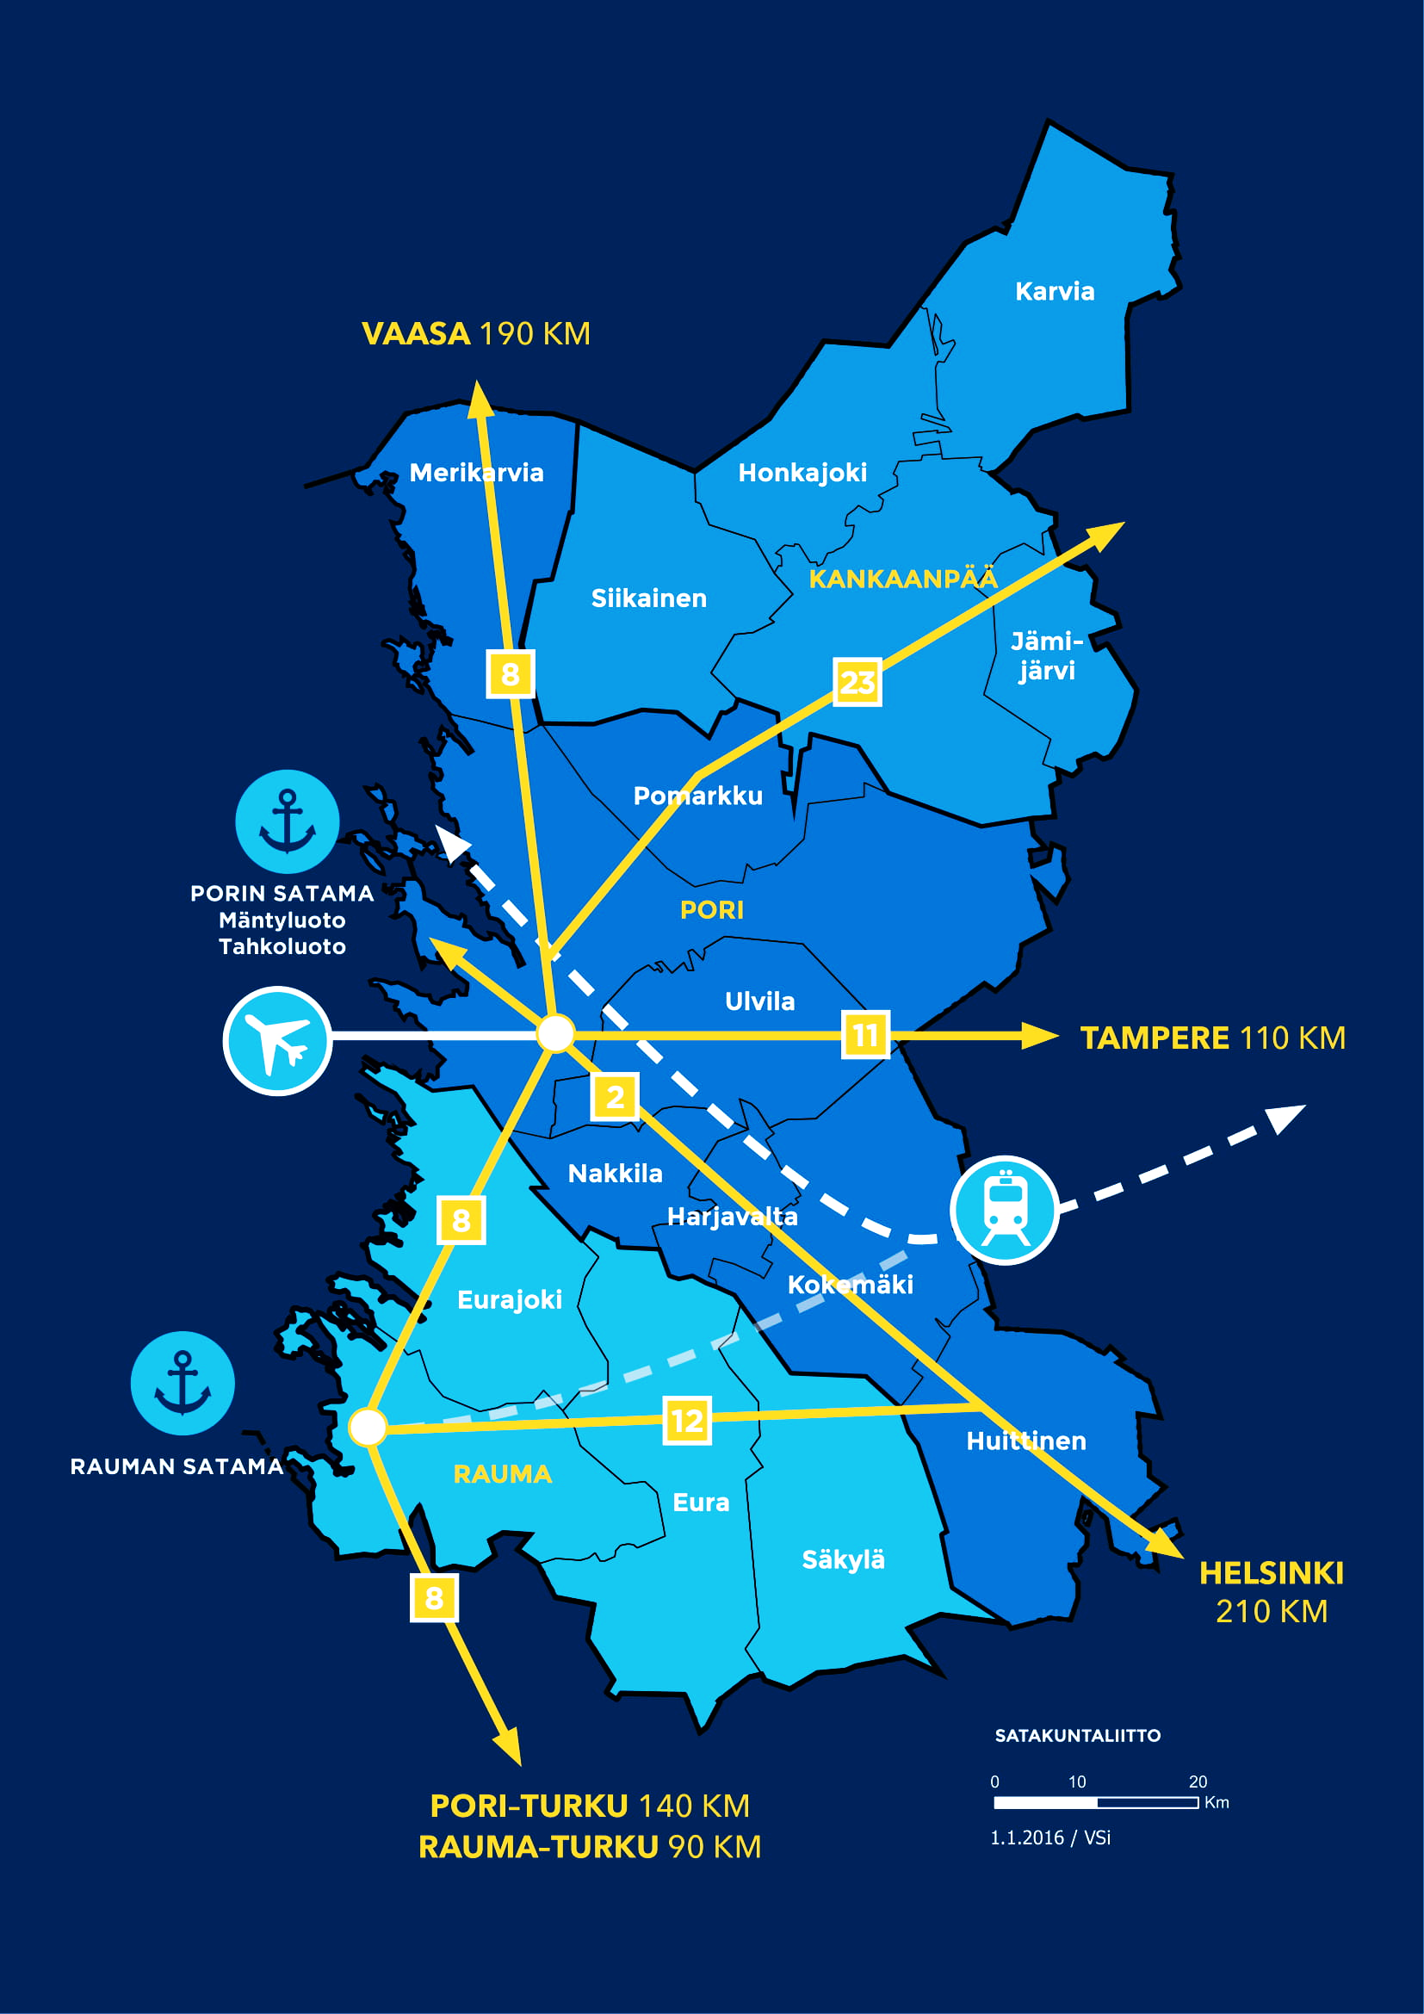
Connections
Satakunta has excellent transport connections both abroad and to other parts of Finland.
PORT OF PORI
2 PORTS RAILWAYS
AIRPORT HIGHWAYS
PORT OF RAUMA
2
8
11
12
23

Slide 4
Pori Airport
Pori Airport has a regular connection to Helsinki serving passenger traffic.
Additionally, being home to the Finnish Aviation Academy, the airport is the most important flight training center in the Finland.
45 min flight time between Pori and Helsinki
Notes:
https://www.karhu.aero/

Slide 5
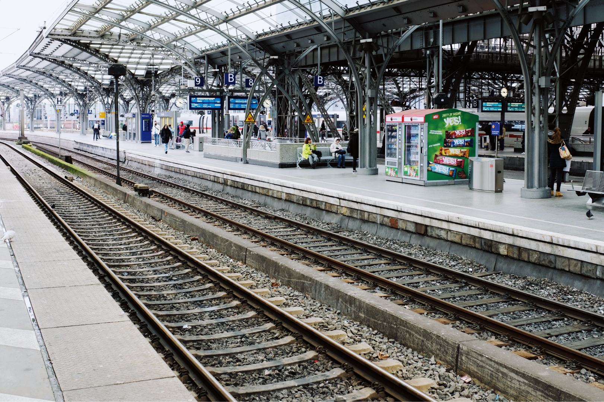
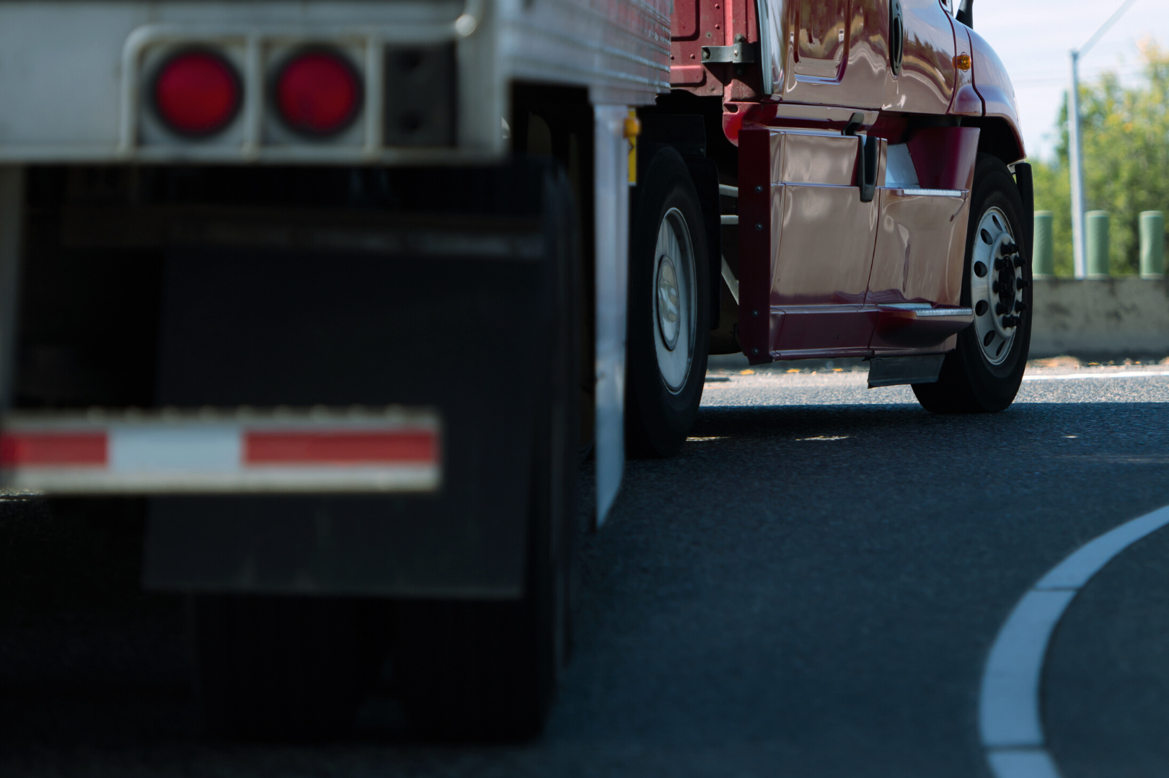
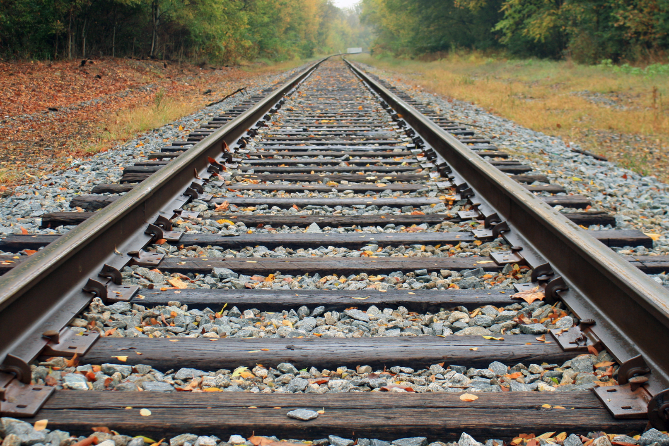
Continuous Improvements to Rail and Road Network
Digirail
Pori-Rauma & Highway 8
Pori-Mäntyluoto-Tahkoluoto

Slide 6
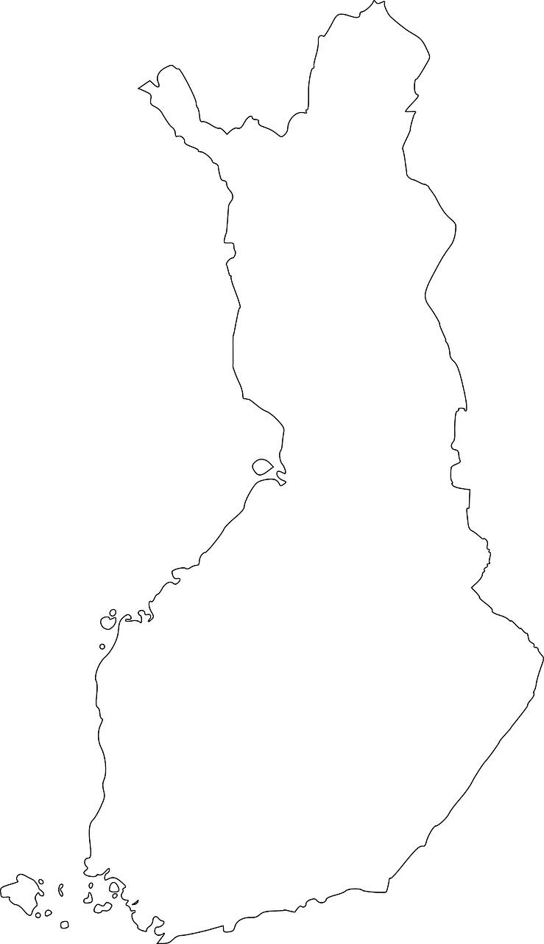
Digirail
Tampere-Pori-Rauma
will serve as a pilot track during 2025-2026 and is thus Finland's first track section where the new system will be introduced
The aim of the project is to modernize the Finnish railway system by utilizing digitalisation and modern technology. The reform of will be based on ERTMS, the European Rail Traffic Management System, which is based on radio network technology.
Benefits:
30% higher rail capacity
More environment-friendly
Better safety
PORI
TAMPERE
RAUMA
Notes:
https://digirata.fi/

Slide 7
Pori-Rauma Track
Highway 8 is significant for the entire Finnish economy. Almost 30% of the value of Finnish exports of goods is produced in the clusters along it. The aim is to make the highway safer, faster and more environmentally friendly for both freight transport and commuting. One significant step in this direction is the development of the Eurajoki downtown area. The intersection is one of the bottlenecks on Highway 8, but with the investment starting in 2021, traffic will be smoother and travel times will be shortened.
AIMS:
4 lanes
30 min Pori-Rauma
Notes:
https://vayla.fi/vt8-turku-pori/eurajoki

Slide 8
Pori-Mäntyluoto-Tahkoluoto
The railway track from Pori to the ports of Mäntyluoto and Tahkoluoto will be electrified during 2020. The traffic on the track consists of transports from the port of Mäntyluoto to the metal cluster in Harjavalta and transports of metal between Pori and Mäntyluoto.
Better cost-effectiveness
More competitive logistics
Less emissions
€
Notes:
https://vayla.fi/pori-mantyluoto

Slide 9
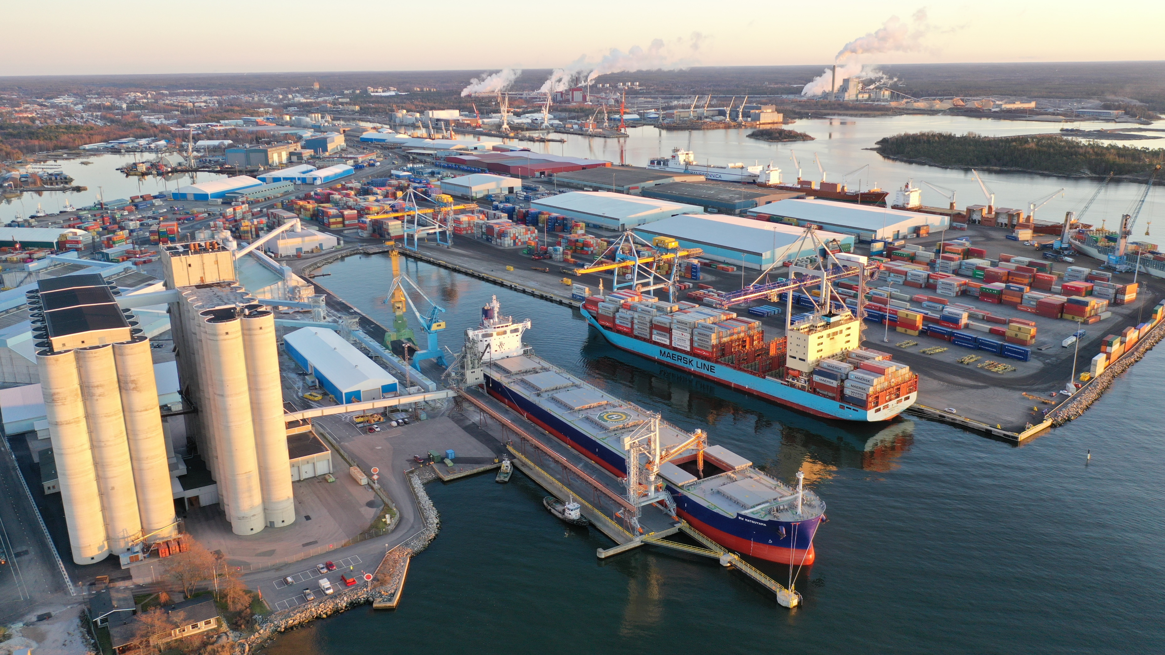
Ports
There are two ports in Satakunta, one in Pori and the other in Rauma. Both are among Finland’s 10 biggest ports measured by international freight transport.
Great locations
Extensive rail network
Favorable ice conditions
Port of Rauma / Ari Ahlfors
Notes:
http://www.satamaliitto.fi/fin/tilastot/kuukausitilastot/?stats=monthly&T=0

Slide 10
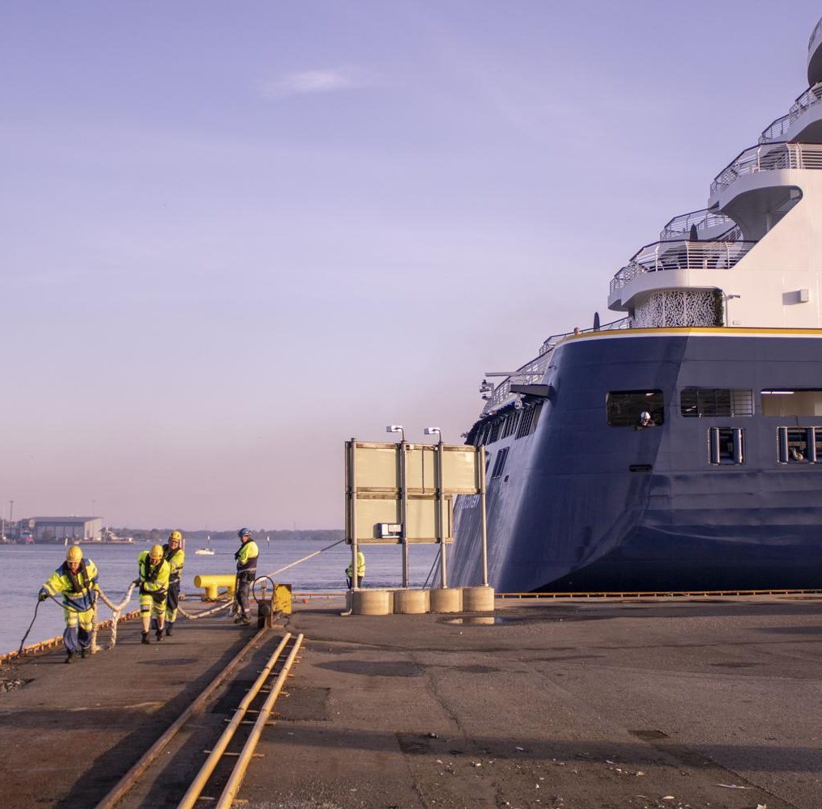
Port of Pori
The Port of Pori is a significant bulk port.
The port consists of two harbors, Mäntyluoto and Tahkoluoto.
FINLAND’S FIRST terminal for the import of liquefied natural gas (LNG) is located in the port area.
Port of Pori

Slide 11
Sustained Growth
9th biggest port in Finland (import + export) 2019
3,36 Mt cargo volume 2018
15,3 m fairway depth ➝ one of the deepest harbors in Finland
Notes:
http://www.satamaliitto.fi/fin/tilastot/kuukausitilastot/?stats=monthly&T=0
https://portofpori.fi/wp-content/uploads/2020/01/port-of-pori_yleisesitys-2020_FI.pdf

Slide 12
Answers to Future Needs
The 30 M€ KALLONLAHTI 2 investment project has been initiated in Mäntyluoto in the Port of Pori. Kallonlahti will havea new 420-metre-long quay with a planned fairway depth of 12 metres and 12.5 hectares of new field area to meet the needs of companies.
RAUANHEIMO, a leading player in bulk handling and transit traffic, is also investing in the Port of Pori. An automated terminal suitable for large flows of bulk goods will be built in Tahkoluoto. → Fast, secure and energy efficient transfer of goods
→ Growth in Tahkoluoto's freight flows
Tahkoluoto is especially suitable for transit traffic thanks to its 15.3 meter fairway depth, good railway connections and excellent ice conditions.
Port of Pori
Notes:
https://portofpori.fi-s.seravo.com/vitality/kallonlahti-2-new-quay/
https://www.rauanheimo.com/en/pori-tahkoluoto-2/

Slide 13
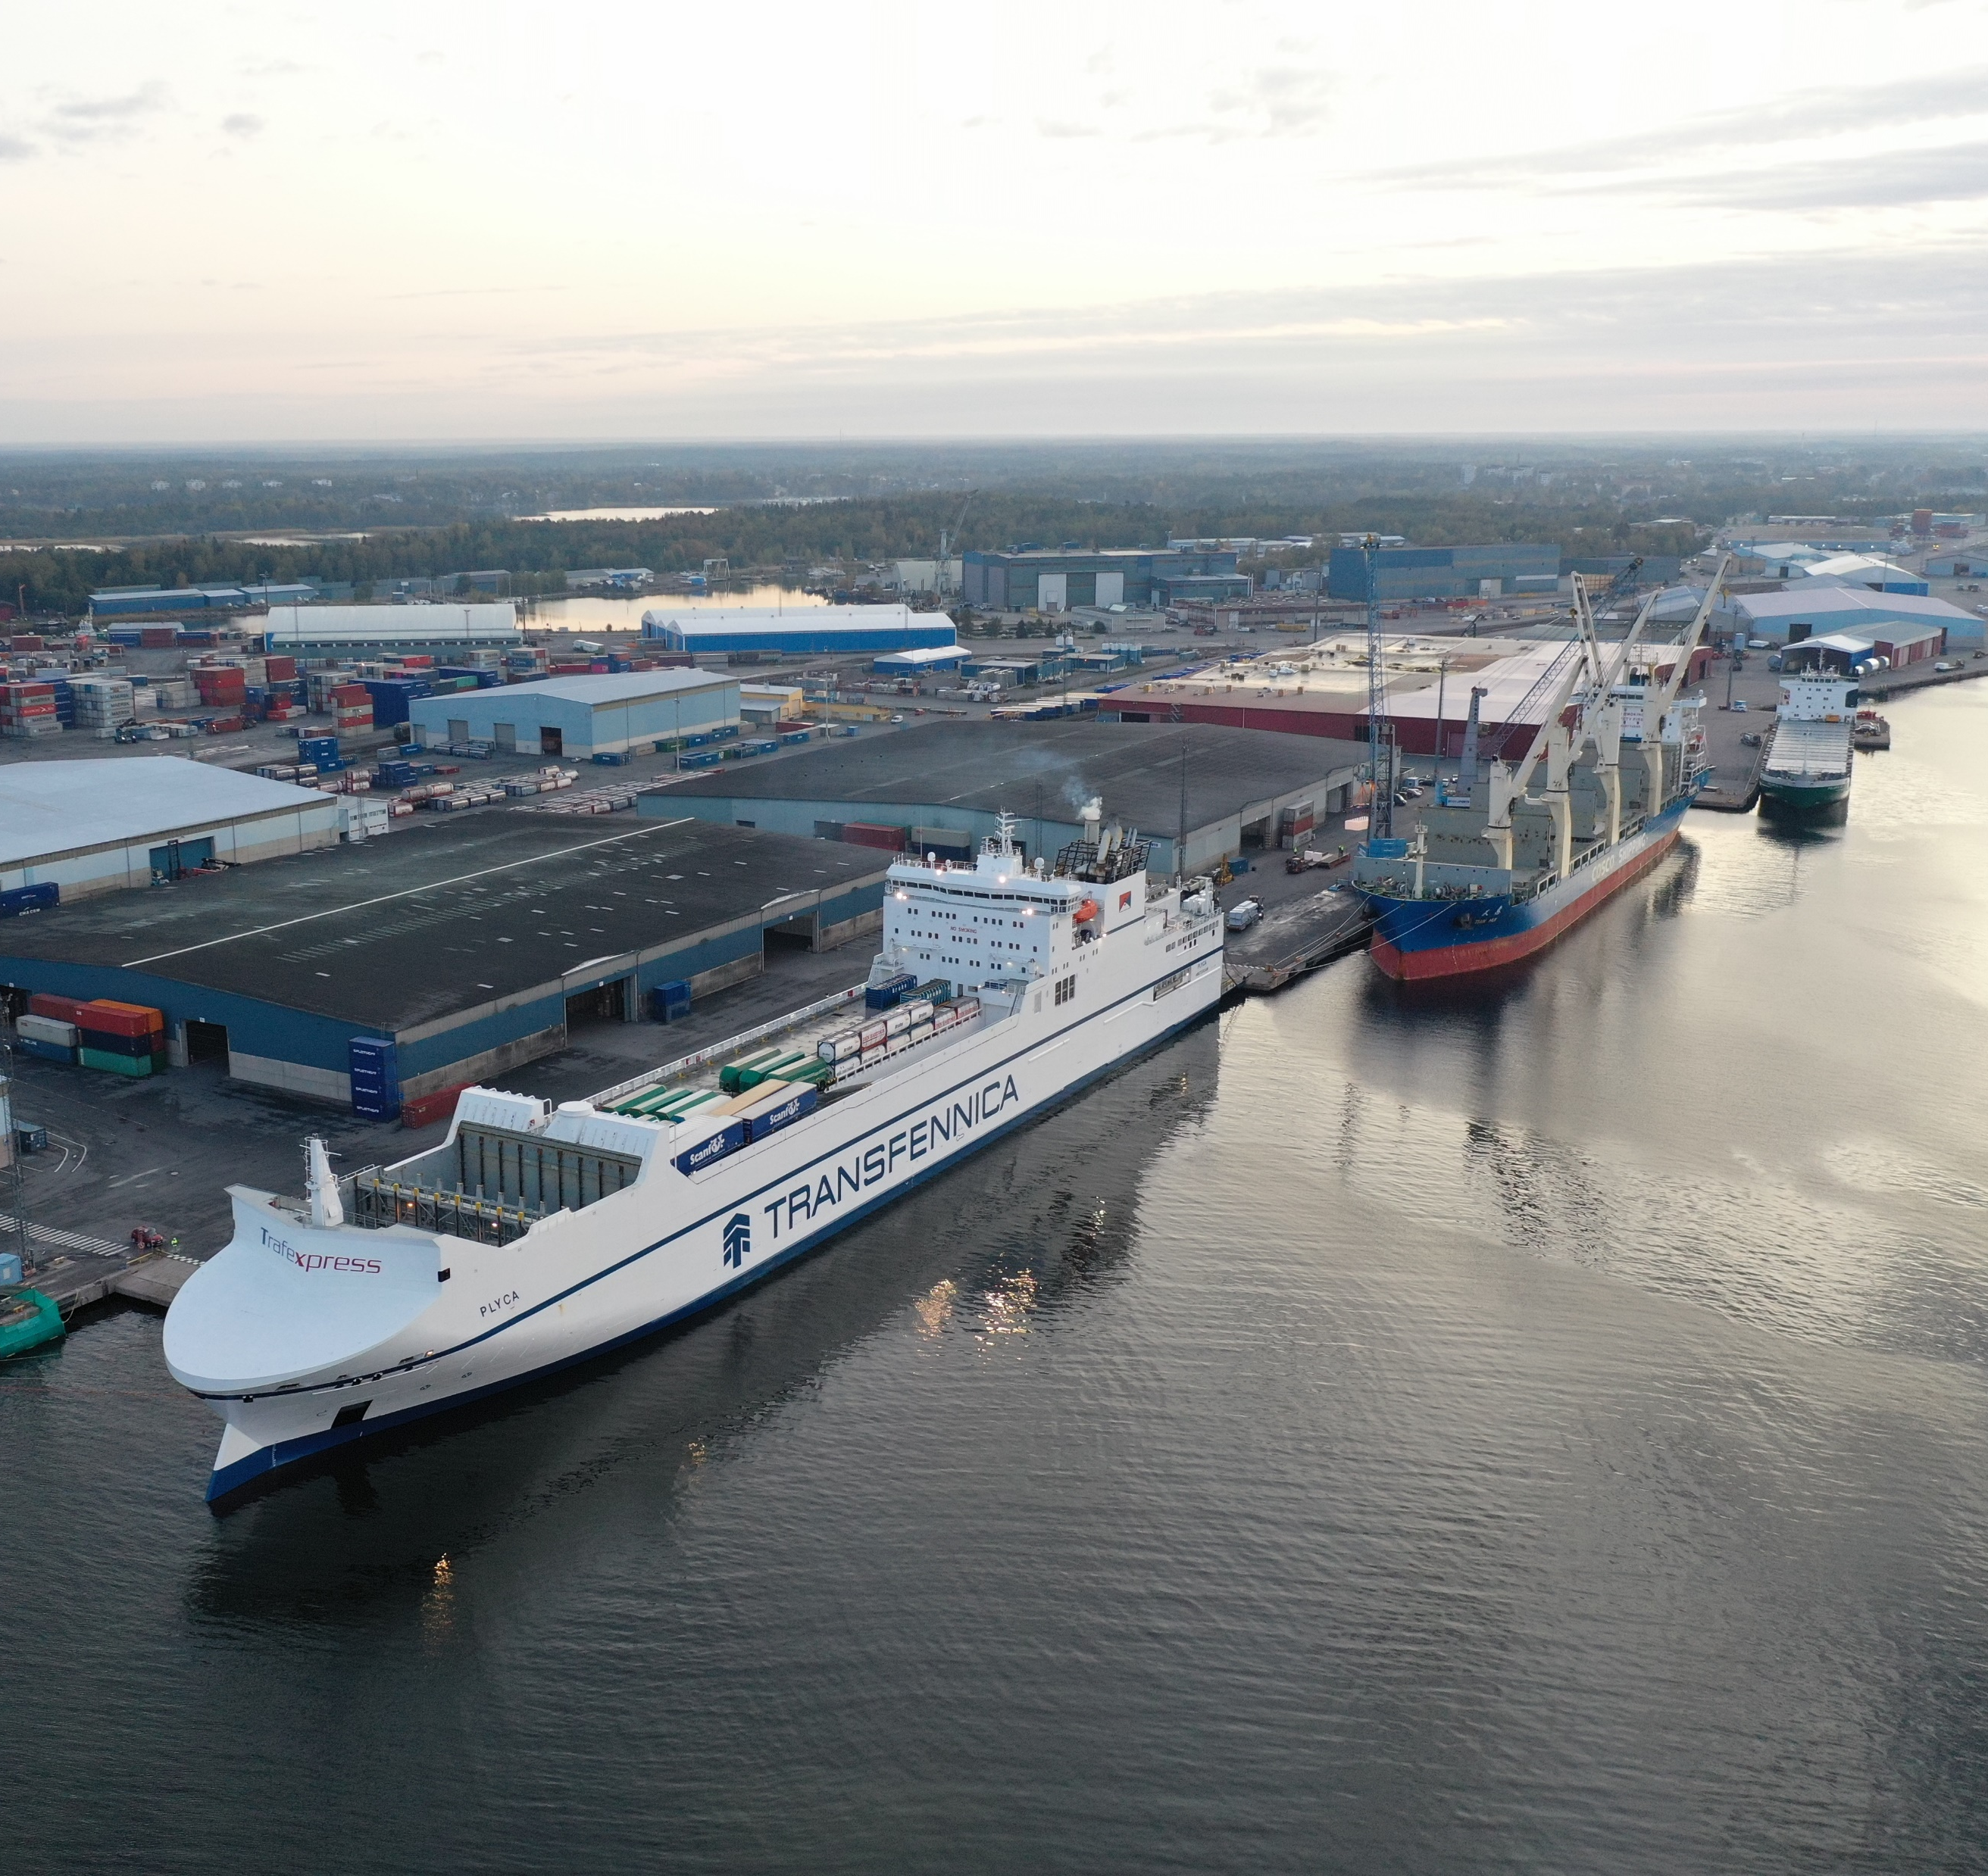
Port of Rauma
The Port of Rauma is extremely important for paper exports. Furthermore, the shipbuilding and maritime cluster Seaside Industry Park is located right next to the port.
Port of Rauma / Ari Ahlfors

Slide 14
Significance for Finnish Freight Transport
4th biggest port in Finland (import + export) 2019
5,83 Mt cargo volume 2019
20 weekly departures to Europe
6 monthly departures to the USA
Notes:
https://portofrauma.com/en/port-of-rauma-ltd/publications-and-media/

Slide 15
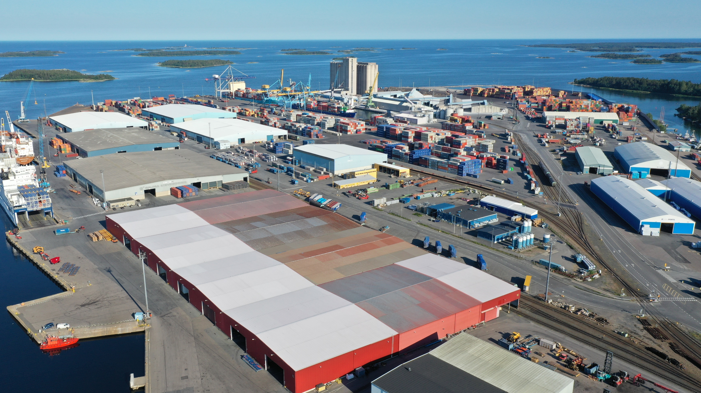
Investing in the Future
Port of Rauma / Ari Ahlfors
The PETÄJÄS 4 expansion project was initiated in the port area in Rauma in 2019.
It is the final step of a larger investment project which creates the necessary conditions for shipping the production of a large sawmill that is being planned in Rauma.
18,5 M€ investment
6 HECTARES new field area
&
Notes:
https://portofrauma.com/en/port-of-rauma-ltd/publications-and-media/

Slide 16
1,7 B€ The value of Satakunta’s goods imports in 2019
Import and Export
3,9 B€ The value of Satakunta’s goods exports in 2019
Notes:
https://tulli.fi/documents/2912305/3672401/Tavaroiden+ulkomaankauppa+maakunnittain+vuonna+2019/33dbd8fd-61cd-4852-6117-5d5301a3f353/Tavaroiden+ulkomaankauppa+maakunnittain+vuonna+2019.pdf?version=1.0

Slide 17
Strong Export-Orientation
2019
6% The value of Satakunta’s goods exports of Finland’s total goods exports
5th largest region in Finland in terms of exports
The share of industries of Satakunta's exports
4% The share of Satakunta’s population of the total population in Finland
➝ exporting 1.5 times the population
Notes:
https://tulli.fi/documents/2912305/3672401/Tavaroiden+ulkomaankauppa+maakunnittain+vuonna+2019/33dbd8fd-61cd-4852-6117-5d5301a3f353/Tavaroiden+ulkomaankauppa+maakunnittain+vuonna+2019.pdf?version=1.0
https://www.tilastokeskus.fi/tup/suoluk/suoluk_vaesto.html
The share of industries:
http://www.satamittari.fi/Vienti
https://tulli.fi/documents/2912305/3672401/Tavaroiden+ulkomaankauppa+maakunnittain+vuonna+2019/33dbd8fd-61cd-4852-6117-5d5301a3f353/Tavaroiden+ulkomaankauppa+maakunnittain+vuonna+2019.pdf?version=1.0

